Slide 1


Non-Pecuniary x402
Reimagining HTTP 402 Payment Required Sans Payment

Slide 2

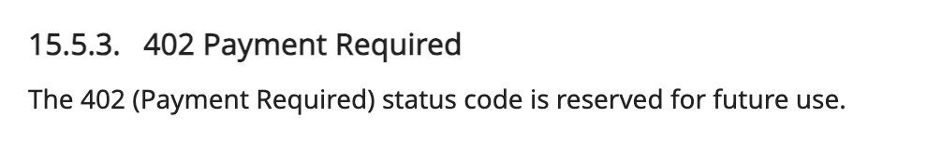
What is the 402 standard?
https://www.rfc-editor.org/rfc/rfc9110.html#section-15.5.3
That’s the entire standard.

Slide 3
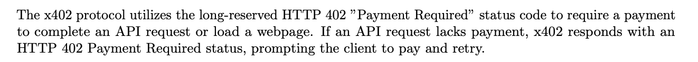
What is x402?

Slide 4
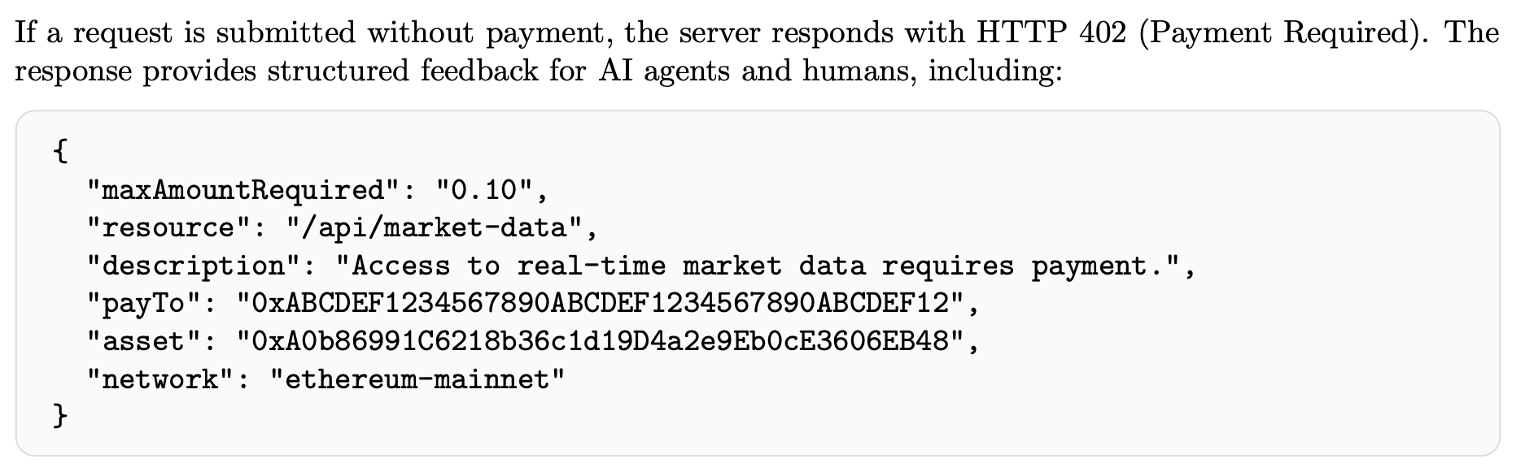

Slide 5


Contact us at:
Kyle MacLean Smith
Email: Kyle@ixian.tech
Telegram: @bestape
X: @bestape
Ixian

Slide 6

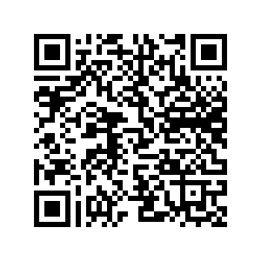
Download these slides here

